Slide 1
Numerical representation and extrapolation using neural arithmetic logic unit
MACHINE LEARNING MINOR PROJECT
Presented By Bharath Kollanur

Slide 2
Failure of neural networks
While Neural Networks are well suited for many image processing tasks, handling sequential data, single neurons often have problems with the calculation of basic mathematical operations [1].
While Neural Networks can successfully represent and manipulate numerical qualities given an appropriate learning signal, the behaviour that they learn does not generally exhibit systematic generalisation [2,3].
Specifically one frequently observes failures when quantities that lie outside the numerical range used during training are encountered at test time, even when the target function is simple.
The failure pattern indicates that the learned behaviour is better characterised by memorisation than by systematic abstraction.

Slide 3
The architecture of the standard feedforward neural network used to demonstrate is as follows:
3 layers ( 2 - Hidden layers , 1- Output layer )
Each hidden layer contains 8 neurons.
L2 Loss function and Stochastic Gradient Descent Optimiser is used.
The following are the activation functions used to demonstrate ( Relu, Sigmoid, Tanh, Relu6, LeakyRelu, ELU, SELU, PRelu, Swish ).
Training data range (-10, 10).
Testing data range (-10, 20 ).

Slide 4
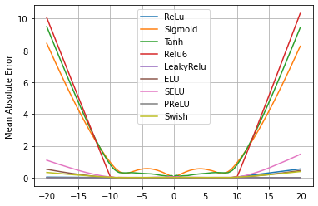
To illustrate the failure of systematicity in standard networks, the behaviour of various MLPs trained to learn the scalar identity function.
The notion that neural networks struggle to learn the identity function is not new[4].
The severity of this failure directly corresponds to the degree of non-linearity within the chosen activation function.

Slide 5
Information about the data
Training data range ( 20 , 40 )
Validating data range ( 20, 40 )
Testing data range ( 0, 60 )

Slide 6
Loss function used in the following project is smooth L1 loss.
$$l_{n}=\{\begin{matrix}0.5(x_{n}-y_{n})^{2}/beta, & if|x_{n}-y_{n}|<beta. \\ |x_{n}-yn|-0.5*beta, & otherwise\end{matrix}$$
Optimiser used in the following project is RMSprop.
$$E[g^{2}]_{t}=βE[g^{2}]_{t-1}+(1-β)(\frac{δC}{δw})^{2}$$
$$w_{t}=w_{t-1}-\frac{η}{\sqrt{E[g^{2}]_{t}}}\frac{δC}{δw}$$
$\frac{δC}{δw}$ — gradient of the cost function with respect to the weight.
$E[g^{2}]_{t}$ — moving average of squared gradients.
$$η-learningrateβ-movingaverageparameter(defaultvallue0.9)$$

Slide 7
Neural accumulator
( NAC )

Slide 8
NAC is a special case of a linear layer whose transformation matrix W consists just of -1, 0 and 1’s; that is its ouputs are additions or subtractions (rather than arbitrary rescaling) of rows in the input vector.
Since hard constraint enforcing that every element of W be one of {-1, 0, 1} would make learning hard, hence a continuous and differentiable parameterisation of W in terms of unconstrained parameters is given as $W=tanh(W^{|}).σ(M^{|})$ These form is convenient for learning with gradient descent[1].
The transformation matrix is element wise dot product of $tanh(W^{|})$ and $σ(M^{|})$.

Slide 9
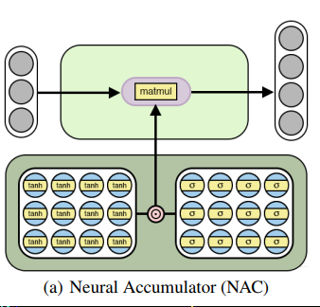

Slide 10
Addition using nac
Accuracy with different operands.
1 operand acts as an identity function.
'Test accuracy for [+] with 1 operands: 100.00%',
'Test accuracy for [+] with 2 operands: 100.00%',
'Test accuracy for [+] with 3 operands: 100.00%',
'Test accuracy for [+] with 4 operands: 100.00%',
'Test accuracy for [+] with 5 operands: 100.00%',
'Test accuracy for [+] with 6 operands: 100.00%’,
'Test accuracy for [+] with 7 operands: 100.00%',
'Test accuracy for [+] with 8 operands: 100.00%',
'Test accuracy for [+] with 9 operands: 100.00%',
'Test accuracy for [+] with 10 operands: 100.00%'

Slide 11
$W^{|}$ = [[9.0109, 9.0112, 9.0109, 9.0111, 9.0111, 9.0110, 9.0110, 9.0110, 9.0110, 9.0111 ] ]
$M^{|}$ = [16.6357, 16.6356, 16.6355, 16.6356, 16.6355, 16.6356, 16.6356, 16.6356, 16.6356 ]]
$W=tanh(W^{|}).σ(M^{|})$
[[1., 1., 1., 1., 1., 1., 1., 1., 1., 1.]

Slide 12
Subtraction using nac
Accuracy with different operands.
1 operand acts as an identity function.
'Test accuracy for [-] with 1 operands: 100.00%',
'Test accuracy for [-] with 2 operands: 100.00%',
'Test accuracy for [-] with 3 operands: 100.00%',
'Test accuracy for [-] with 4 operands: 100.00%',
'Test accuracy for [-] with 5 operands: 100.00%',
'Test accuracy for [-] with 6 operands: 100.00%’,
'Test accuracy for [-] with 7 operands: 100.00%',
'Test accuracy for [-] with 8 operands: 100.00%',
'Test accuracy for [-] with 9 operands: 100.00%',
'Test accuracy for [-] with 10 operands: 100.00%'

Slide 13
$W^{|}$ = [[-9.0109, -9.0109, -9.0111, -9.0112, -9.0110, -9.0109, -9.0110, -9.0111, -9.0111, -9.0110 ] ]
$M^{|}$ = [[16.6355, 16.6356, 16.6356, 16.6355, 16.6355, 16.6355, 16.6356, 16.6355, 16.6356, 16.6356 ]]
$W=tanh(W^{|}).σ(M^{|})$
[[-1., -1., -1., -1., -1., -1., -1., -1., -1., -1.]

Slide 14
Random function using nac
Y = x1 + x2 - x3 + X4 - x5 + x6 - x7 - x8
$W^{|}$ = [ 8.6499, 8.4963, -8.4905, 8.6622, -8.4617, 8.5317, -8.4859, -8.5097]
$M^{|}$ = [14.0710, 14.0996, 14.1673, 14.0797, 14.1597, 14.0898, 14.1709, 14.1493]
$W=tanh(W^{|}).σ(M^{|})$
[ 1.0000, 1.0000, -1.0000, 1.0000, -1.0000, 1.0000, -1.0000, -1.0000]

Slide 15
Neural arithmetic logic unit
( NAlu )

Slide 16
The Neural Arithmetic Logic Unit (NALU) uses two NACs with tied weights to enable addition /subtraction and multiplication/division, controlled by a gate.
The two NACs cells are interpolated by a learned sigmoidal gate g, such that if the add/subtract sub cells output value is applied with a weight of 1 (on), the multiply/divide subcells is 0(off) and vice versa.
The first NAC computes the accumulation vector a, it is computed exactly as original NAC,
The second NAC operates in log space and is therefore capable of learning to multiply and divide storing its result in m.
$NAC:a=Wx$. $W=tanh(W^{|}).σ(M^{|})$
$NALU:y=g.a+(1-g).m$ $m=expW(log(|x|+ϵ)),g=σ(Gx)$

Slide 17
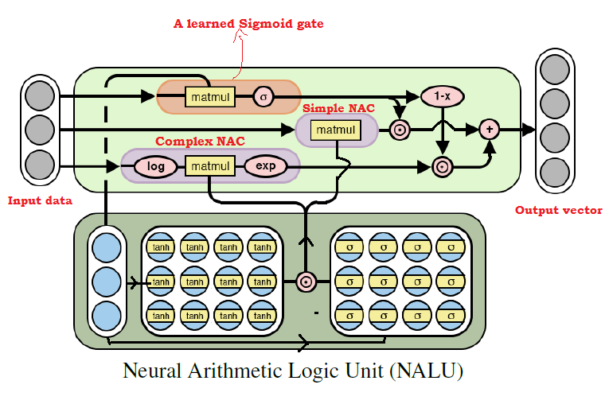

Slide 18
Arithmetic operations using naLU
Accuracy with different two operands on different operators.
Test Accuracy for [+] : 99.80%
Test Accuracy for [-] : 87.30%
Test Accuracy for [*] : 92.30%
Test Accuracy for [/] : 98.60%
Test Accuracy for [sqrt] : 99.10%
Test Accuracy for [^2] : 91.60%

Slide 19
Arithmetic operations using naLU
Accuracy with different five operands on different operators.
Test Accuracy for [+] : 100.00%
Test Accuracy for [-] : 98.90%
Test Accuracy for [*] : 93.90%
Test Accuracy for [/] : 18.70%

Slide 20
Initialisation sensitivity
From observation NALU architecture is very prone to non optimal initialisation, which can lead to vanishing gradients or optimisation into undesired local optima.
NALU Architecture doesn’t recover from local optima by its own [5].
A strategy is followed in these project, This strategy evaluates the loss for each m-th epoch and randomly initialises all weights if the loss did not improve for the last n steps.

Slide 21
Future work
The NALU design isn’t capable of multiplying or dividing values with a negative result.
Independent weights

Slide 22
References
A. Trask, F. Hill, S. E. Reed, J. Rae, C. Dyer, and P. Blunsom. Neural Arithmetic Logic Units. In Advances in Neural Information Processing Systems, pages 8035-8044, 2018.
C. Randy Gallistel. Finding numbers in the brain. Philosophical Transactions of the Royal Society B, 373, 2017.
Gary F. Marcus. The Algebraic Mind: Integrating Connectionism and Cognitive Science. MIT Press, 2003
Kaiming He, Xiangyu Zhang, Shaoqing Ren, and Jian Sun. Identity mappings in deep residual networks. CoRR, abs/1603.05027, 2016. URL http://arxiv.org/abs/1603.05027
A. Madsen and A. Rosenberg Johanen. Measuring Arithmetic Extrapolation Performance. 2019.

Slide 23
Thank you

